Slide 1
Debug in linux

Slide 2
1. GDB
2. Coredump
3. Signal
4. Kernel Oops
5. ABI

Slide 3
GDB
Gcc –g 参数
Dwarf信息：objdump –s executable
Breakpoint
Watchpoint
调用栈的Backtrace.

Slide 4
GDB
How backtrace work(unwind the stack).
Call procedure(push rip, then jump)
Push %rbp (save rbp)
Mov %rsp,%rbp(save current rsp)
Sub $0x??,%rsp
Leaveq (set rsp=rbp, pop rbp)
Retq (pop rip)

Slide 5
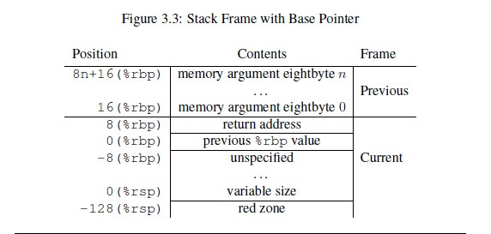
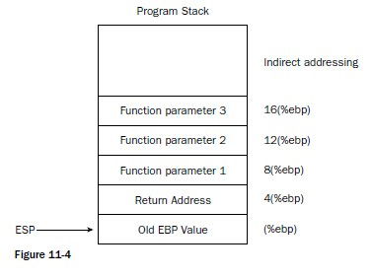
GDB

Slide 6
GDB
How breakpoint implemented.
Gdb based on Ptrace
PTRACE_SINGLESTEP
__asm__ volatile ("int $0x3"); is breakpoint
Example:
http://www.linuxjournal.com/article/6100
http://www.linuxjournal.com/article/6210

Slide 7
coredump
程序崩溃时的信息存储到coredump中。
使用如下命令打开coredump功能：ulimit -c unlimited
用gdb调试程序时，如果程序是带debug信息的，gdb显示的信息比较详细，否则可能需要通过汇编代码反推程序出错语句。
gdb --core=core executable

Slide 8
Signal
Kill –l to list all the signals
给程序添加信号处理函数，打印出错状态详细信息。
Example for powerpc architecture:
http://www.ibm.com/developerworks/cn/linux/l-sigdebug.html

Slide 9
Kernel oops.
[ 621.310588] Oops: 0002 [#1] SMP
[ 621.310590] Modules linked in: mod(OF+) snd_intel8x0 snd_ac97_codec ac97_bus snd_pcm snd_page_alloc snd_seq_midi snd_seq_midi_event snd_rawmidi bnep rfcomm bluetooth snd_seq snd_seq_device joydev snd_timer psmouse serio_raw snd i2c_piix4 mac_hid parport_pc soundcore ppdev lp parport hid_generic usbhid hid ahci libahci e1000
[ 621.310605] CPU: 0 PID: 3052 Comm: systemd-udevd Tainted: GF O 3.13.0-24-generic #46-Ubuntu
[ 621.310607] Hardware name: innotek GmbH VirtualBox/VirtualBox, BIOS VirtualBox 12/01/2006
[ 621.310609] task: ffff8800691cdfc0 ti: ffff8800481a0000 task.ti: ffff8800481a0000
[ 621.310610] RIP: 0010:[<ffffffff8136a67d>] [<ffffffff8136a67d>] memcpy+0xd/0x110
[ 621.310612] RSP: 0018:ffff8800481a1bb0 EFLAGS: 00010046
[ 621.310613] RAX: 0000000000000000 RBX: ffff88007ab33480 RCX: 0000000000000200
[ 621.310614] RDX: 0000000000000000 RSI: ffffffffa12052c0 RDI: 0000000000000000
[ 621.310615] RBP: ffff8800481a1bc8 R08: 0000000000000000 R09: ffff880078abdc00
[ 621.310616] R10: 00000001fe200000 R11: fffffffe01e07f88 R12: ffff880078a36a20
[ 621.310617] R13: ffff880078a36a20 R14: 0000000000000001 R15: 0000000000000000
[ 621.310619] FS: 00007f952c47d880(0000) GS:ffff88007fc00000(0000) knlGS:0000000000000000
[ 621.310620] CS: 0010 DS: 0000 ES: 0000 CR0: 0000000080050033
[ 621.310621] CR2: 0000000000000000 CR3: 0000000061f17000 CR4: 00000000000006f0
[ 621.310626] Stack:
[ 621.310627] ffffffffa02130a1 ffff880078a36a20 ffff880078a36a20 ffff8800481a1be0
[ 621.310629] ffffffff813317d3 ffff8800481a1c30 ffff8800481a1c18 ffffffff8133188a
[ 621.310631] ffff8800481a1c30 0000000000000000 ffff880078a36a20 0000000000000001
[ 621.310633] Call Trace:
[ 621.310637] [<ffffffffa02130a1>] ? simp_blkdev_do_request+0xa1/0xcb [mod]
[ 621.310641] [<ffffffff813317d3>] __blk_run_queue+0x33/0x40
[ 621.310643] [<ffffffff8133188a>] queue_unplugged+0x2a/0xa0
[ 621.310645] [<ffffffff813350e0>] blk_flush_plug_list+0x1f0/0x230
[ 621.310674] Code: 43 4e 5b 5d c3 66 0f 1f 84 00 00 00 00 00 e8 fb fb ff ff eb e2 90 90 90 90 90 90 90 90 90 48 89 f8 48 89 d1 48 c1 e9 03 83 e2 07 <f3> 48 a5 89 d1 f3 a4 c3 20 4c 8b 06 4c 8b 4e 08 4c 8b 56 10 4c
[ 621.310691] RIP [<ffffffff8136a67d>] memcpy+0xd/0x110
[ 621.310692] RSP <ffff8800481a1bb0>
[ 621.310693] CR2: 0000000000000000

Slide 10
kdump
Kdump是一个Linux内核崩溃转储机制，这个机制的原理是在内存中保留一块区域，这块区域用来存放capture kernel，当前的内核发生crash后，通过kexec把保留区域的capture kernel运行起来，由capture kernel负责把crash kernel的完整信息--包括CPU寄存器、堆栈数据等--转储到文件中，文件的存放位置可以是本地磁盘，也可以是网络。
https://wiki.ubuntu.com/Kernel/CrashdumpRecipe

Slide 11
ABI(Application binary interface)
定义数据类型大小
定义函数调用中：寄存器，栈如何使用，参数如何传递。
定义操作系统接口
定义dwarf版本。
定义栈回溯算法。
定义可执行文件格式。
定义程序链接方式。

Slide 12
Related code

Slide 13

问题

